Slide 1
ITSM – Session 8
Dr. Phalachandra HL
Acknowledgements:
Significant portions of the information in the slide sets presented through the course in the class are extracted from IT Systems Management -Rich Schiesser and other books/Internet. Since these were intended for presentation in the class room for teaching, instructor resources has been requested from the publisher, but not received yet. I would like to sincerely thank, acknowledge and reiterate that the credit/rights remain with the original authors/publishers only

Slide 2
IT Systems Management
Recap
IT Infrastructure Systems Management involves managing the IT Services running on the IT infrastructure environment components like the Servers, Disk Storage, DBs, Networks and Desktop environments, and providing a stable and responsive IT environment, which supports or furthers the Business of the organization, while being Available, Responsive, Cost efficient, Secure, Scalable,…
We discussed on the support needed from executives, organization structure and positioning of the groups which provide these management services, given that one of the KSF are people, we discussed on approaches for staffing and retaining people with required skills and skill levels, the personal and business ethics or lack of it and it’s impact in-terms of legislation and what that drives into organizations
We also looked at how to evolve the services to a customer centric approach and leveraging the best practices using frameworks like ITIL
Then as part of the 12 Key processes which would discuss as part of the course, we discussed on the processes for managing Availability, Performance –Tuning, Production Acceptance process, Change Management and Problem Management, Storage Management and Network Management.

Slide 3
IT Systems Management
Recap - 1
As part of discussing the Storage Management process we discussed on the characteristics of the Storage Management Process owner. We then looked at the five major areas considered as part of the storage management process: capacity, performance, reliability, recoverability and Integrity and discussed on each of them.
We looked at techniques to manage storage capacity from both a strategic and tactical standpoint. A number of performance considerations were discussed to optimize overall data-transfer rates in large-capacity storage arrays. We also discussed reliability very specifically RAID. We looked at recoverability in terms of various backup strategies. We then looked at Integrity of data at rest and on the wire.
We also looked at Network Management process, by briefly looked at the technologies involved with Network Management in terms of NM using the OSI model or the IETF based models and that was not the withing the context of Network Management as an ITSM process.

Slide 4
IT Systems Management
Recap -2
We then defined Network Management as a process focused to maximize the reliability and utilization of network components in order to optimize network availability and responsiveness. This involved managing high levels for uptime and performance and tuning of all of the network components.
We discussed on how the different processes discussed upto now like the Availability management and Performance tuning addressed a lot of NM perspectives as part of it. Given that context in lieu of looking at NM as an independent processes we looked at NM in conjunction of other processes and looked at positioning into the environment.
So we said in typical integrated environments, we needed to make some key decisions to implement a robust network management process. These were with network processes rather than with network technology. These dealt with what to manage, who would manage and with what authority, tools (NM and ND) used for supporting the same, and how will this be integrated to other processes like availability, performance, problem management, Storage Management and Network Management etc.
We also discussed on how these processes (Storage and Network management) processes could be assessed using worksheets and how each of the processes could be fine tuned based on the service and process metrics.

Slide 5
Configuration Management
BITS Pilani, Deemed to be University under Section 3 of UGC Act, 1956

Slide 6
Discussions
What in your opinion is Configuration Management and specifically as an ITSM processes?
How Important/Interesting .. Why

Slide 7
Configuration Management
Introduction
Configuration Management involves
Defining and maintaining descriptions and relationships between key resources required to deliver IT enabled Services
This would include collecting the configuration information
Establishing baselines of the documentation (Snap Shot)
Verifying the established baselines of the configuration
Auditing the configuration information
Typically this is not one of the most appealing, but is a necessary activity for maintaining the IT systems.
Infrastructures can become world-class only when the IT infrastructure is orchestrated most efficiently and consistently and this involves documentation of hardware and software configurations factoring in their interrelationships. If not managed, this could lead to impact to restoration of services or implementing changes without clarity on the impacts, which can impact business and cost,.

Slide 8
Configuration Management
Other Goals of Configuration Management
IT configuration repository is accurate, complete and up to date
IT Compliance and support for business compliance with external laws and regulations (including licenses)
Optimization of IT assets, resources and capabilities
Availability of reliable and useful information for decision making
Ability to provide a high-level view (using CMDB) to analyze performance/change etc.
Support Change Management management
Service Catalog and support for problem management (Identify, Workaround, Communication)
From a Business perspective
Improve Stakeholder value, Business service continuity and availability
Information based strategic decision making
Optimization of service delivery costs

Slide 9
Configuration Management
Key Practices followed
Establish and maintain a configuration model
Establish and maintain a configuration repository and baseline
Maintain and control configuration items
Produce status and configuration reports
Verify the integrity of the configuration repository

Slide 10
Configuration Management
Introduction
Definition of Configuration Management : Configuration management is a process to ensure that the interrelationships of varying versions of infrastructure hardware and software are documented accurately and efficiently to keep the environment in a desired consistent state
Configuration management in an IT Infrastructure perspective refers to coordinating and documenting the different levels of hardware, firmware, and software that comprise servers, desktops, databases, and various network devices such as routers, hubs, and switches
IT infrastructure has different models of devices like servers, with each of the devices which can run different OS versions, H/W Configurations, Firmware like PDC, IODCs, Intel EFI Firmware versions and number of other software with different versions.
Keeping track of a functioning combination of all of these H/W, F/W and S/W, and keeping them updated accurately is the primary responsibility of the configuration management process owner

Slide 11
Configuration Management
Introduction
Along with the H/W, S/W and F/W versions of the IT infrastructure components also needs to document other information of the network like the circuit diagrams, network configurations, and backbone schematics.
Configuration Item (CI) records these configuration items .. and could be stored in Configuration Management Data Base (CMDB)
Multiple CMDBs could form CMS (Configuration Management System) which is typically used with ITIL
Contrasting - Application configuration management is typically called version control, deals with managing different levels of outcomes from various phases within an SDLC, and is managed by the Lifecycle processes which are chosen.
Contrasting - Device configuration, which involves modifying or tuning of different configurable or modifiable parameters of a device/system which can change its behavior.
Configuration Management activity as with the IT Infrastructure management, needs a different mindset and needs to be carefully chosen.

Slide 12
Configuration Management
Steps for Effective configuration Management
Some practical steps for effective configuration management of an IT environment
Select a qualified process owner
Acquire the assistance of a technical writer or a documentation analyst.
Match the backgrounds of writers to technicians.
Evaluate the quality and value of existing configuration documentation.
Involve appropriate hardware suppliers.
Involve appropriate software suppliers.
Coordinate documentation efforts in advance of major hardware and software upgrades.
Involve the asset‐management group for desktop equipment inventories
Ensure that the configuration management activities would be followed

Slide 13
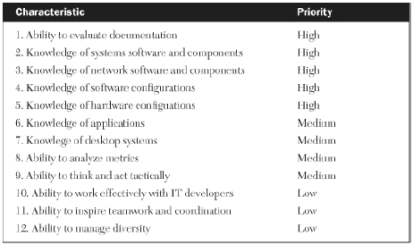
Configuration Management
Steps for Effective configuration Management - 1
Select a qualified process owner
Most instances there will be a single configuration management process owner
The process owner should have strong working knowledge of system and network components and H/W, S/W components.
Acquire the assistance of a technical writer or a documentation analyst
A Technical writer who can generate narratives, verbiage or procedures or A documentation analyst who can produce diagrams, flowcharts, or schematics can help in clear, accurate documentation in a fairly quick manner.
Notes:
Quality and Value

Slide 14
Configuration Management
Steps for Effective configuration Management - 2
Acquire the assistance of a technical writer or a documentation analyst (Contd.)
Having a technical writer or a documentation analyst removes the need of detailed documentation to be done by a technical specialist, and allows them to focus on technology, This allows the usage of personnel who are strong in documentation to assist on this detailed documentation activity.
The argument that this increases costs can be addressed by contracting this out or hiring part time or shared folks to support the same or by using tools which are available.
Match the Backgrounds of Writers to Technicians
If a technical writer or documentation specialist is hired, then matching the background of the writers and the technicians to the specification of the document, whether its the Servers, Disk Volumes, DBs, Networks or Desktops, can bring about a better finished documentation.
Evaluate the Quality and Value of Existing Configuration Documentation
Evaluating existing documentation can indicate the quality and value of prior efforts at recording current configurations.
Identifying which pieces of documentation are most valuable to an organization, and then looking at the existing quality and value of the documentation, areas for improvement can be identified.

Slide 15
Configuration Management
Steps for Effective configuration Management - 3
Involve Appropriate Hardware Suppliers
Different models of server hardware may support only limited versions of OS, Different sizes of disk arrays will support differing quantities and types of channels, cache, disk volumes, and densities. The same is true for tape drive equipment, Network components (such as routers and switches) and desktop computers which all come with a variety of features, interconnections, and enhancements.
Involving Hardware Suppliers in qualification and building a support matrix could help keep the documentation current and understandable.
Involve Appropriate Software Suppliers
Infrastructure software suppliers can help in terms of providing information on levels of software and models of hardware.
Changes to the software levels could lead to continual updates to the software and hardware configurations.
Software for database management, performance monitoring, and data backups also comes in a variety of levels and for specific platforms. Suppliers can be helpful in setting up initial configurations such for complex disk to tape backup schemes and may also offer online tools to assist in the upkeep of the documentation

Slide 16
Configuration Management
Steps for Effective configuration Management - 4
Coordinate Documentation Efforts in Advance of Major Hardware and Software Upgrade
Upgradation of major hardware components such as multiple servers or large disk arrays can render volumes of configuration documentation obsolete
Coordinating in advance and simultaneously the many different documentation updates with the appropriate individuals can save time, reduce errors, and improve cooperation among disparate groups
Involve the Asset-Management Group for Desktop Equipment Inventories
Desktop environment has large number of types and features for configuration
Typically this function is moved over to a procurement or purchasing department.
Asset management can serve as a tremendous resource for keeping track of the myriad paperwork tasks associated with desktops, including the names, departments, and location of users; desktop features; software licenses and copies; hardware and software maintenance agreements; and network addresses
Configuration management process can coordinate all the activities while using the asset management system

Slide 17
Configuration Management
Steps for Effective configuration Management - 5
Ensure that the configuration management would consist of
Planning
Identification
Control
Status accounting
Verification & Audit
Not part of the book but this step needs to be enforced by the Effective configuration process as a set of activities which will be executed

Slide 18
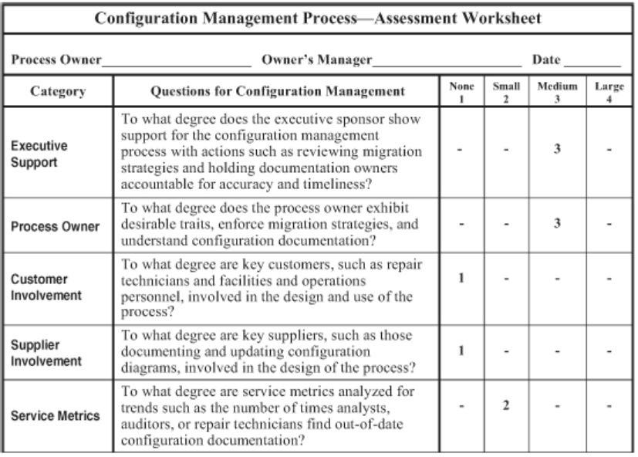
Configuration Management
Assessing an Infrastructure’s Configuration Management Process
Like with the other processes, the following worksheet quick-and-simple method for assessing the overall quality, efficiency, and effectiveness of a configuration management process

Slide 19
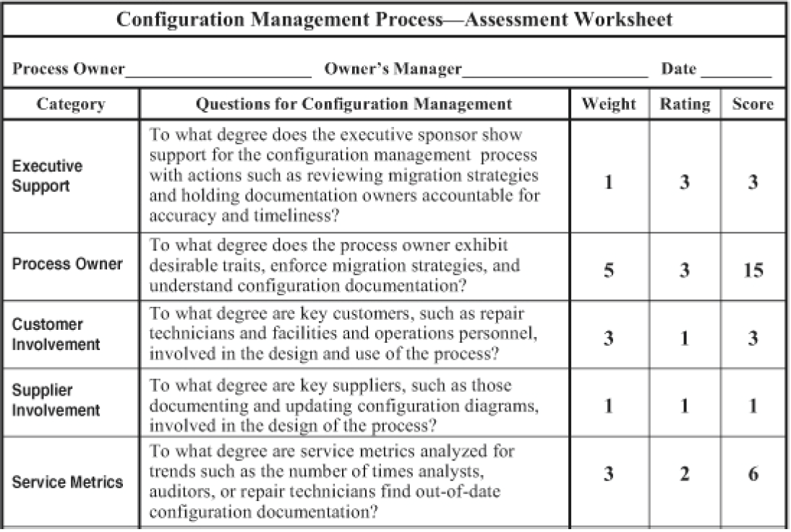
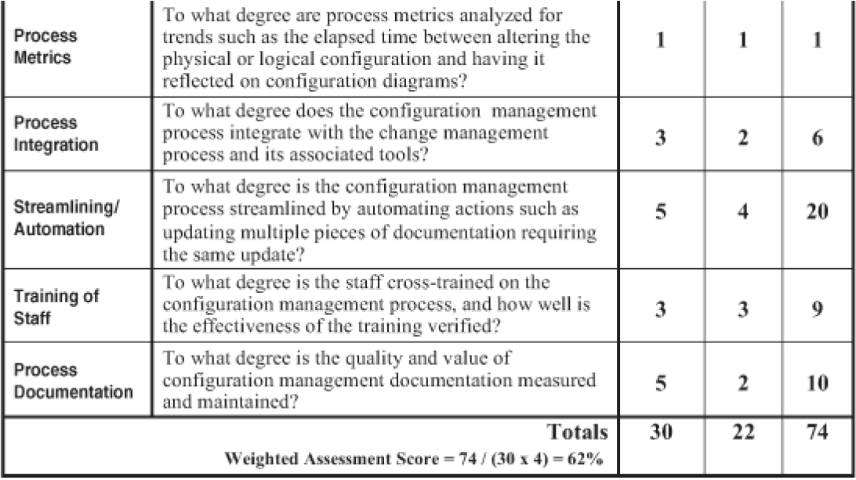
Capacity Planning
Assessing an Configuration Management Process
If we need to tailor this for a specific organization, then with weightages

Slide 20
Configuration Management
Measuring and Streamlining the Configuration Management Process
We can measure and streamline the Configuration management process with the help of the assessment worksheet
We can measure the effectiveness of a Configuration management process with service metrics such as the number of times analysts, auditors, or repair technicians find out-of-date configuration documentation.
Process metrics, such as elapsed time between altering the physical or logical configuration and noting it on configuration diagrams, help us gauge the efficiency of this process.
We can streamline the configuration management process by automating actions such as the updating of multiple pieces of documentation requiring the same update

Slide 21
Discussions
Configuration Management
Do you believe your organization has a good configuration management processes
How does your organization manage configuration management - Do SME put them together or do you have some documentation engineers doing it?
How does Configuration Management work within your organization
Notes:
Standards
COBIT Control Objectives for Information Technologiess
Build Acquire and Implent – BAI10
Tools
Puppet
Chef

Slide 22
Capacity Planning
BITS Pilani, Deemed to be University under Section 3 of UGC Act, 1956

Slide 23
Capacity Planning
Introduction
Capacity planning is the process of estimating the needs of Infrastructure resources for anticipated needs of the future.
Capacity planning from a performance specialist perspective, needs to keep the utilization of the infrastructure resources at a level where best performances can be achieved,
Capacity planning from a financial perspective, needs to optimize and ensure max utilization of the resources before looking for additional capacity.
Good capacity planning leads to effective planning of capital budgets, avoidance of costly downtime, and better management of risk across the portfolio of IT applications
Improperly capacity planned infrastructure, can lead to Business services suffering issues like longer response times for users, unavailable applications and unacceptable performance, or unused resources

Slide 24
Capacity Planning
Introduction & Topics planned
Capacity Planning
Capacity planning is a process to predict the types, quantities, and timing of critical resource capacities that are needed within an infrastructure (or assessing when, how much, and what type of additional hardware resources will be needed), to support accurately forecasted workloads
This leads to
Types of resources to be planned: servers, disk space, or Network bandwidth
Quantities : The quantities or the size of the resource in question
Timing of when needed: The timing of when the additional capacity is needed
Basis of Capacity Planning: Capacity planning decisions are effective if they are based on sound and thorough forecasts of anticipated workload demands and reflect the real-world performance data

Slide 25
Capacity Planning
Capacity Planning is challenging and seldom done well
Although the importance of needing to adequately plan for & to provide capacity is well understood, this is seldom well done potentially due to some of the following reasons.
Analysts are too busy with day‐to‐day activities
Infrastructure system Analysts and Application program analysts are typically involved with other activities and don’t spend enough time
Identifying a person as capacity planning owner and empowering the person to negotiate with developers and users on capacity planning issues
Users are not interested in predicting future workloads
Users have an emphasis on here and now, not on future growth in workloads
Developers can help in providing justification for capacity needed and also help in developing questions/worksheets for collecting future workload information from users

Slide 26
Capacity Planning
Capacity Planning is challenging and seldom done well - 2
Users who are interested cannot forecast accurately.
End-users may not have the skills, experience, or tools to forecast workload increases to ensure acceptable future performance
Joint consultations with both developers and capacity planners who can show users how to do this can help alleviate this drawback
Capacity planners may be reluctant to use effective measuring tools.
New Capacity planners may be reluctant to use new or complex measurement tools that they may have just inherited.
Cross-training, documentation, consultation with the vendor, and turnover from prior users of the tool can help overcome this reluctance
Corporate or IT directions may change from year to year.
Strategic directions within a corporation / IT organization change so rapidly that any attempt at strategic capacity planning becomes futile

Slide 27
Capacity Planning
Capacity Planning is challenging and seldom done well - 3
Planning is typically not part of an infrastructure culture.
Most IT organizations are focused on day-to-day tactical operations of an IT production environment and capacity planning is more for budgetary purposes
Having a dedicated IT Infrastructure capacity planning group would help.
Managers sometimes confuse capacity management with capacity planning.
Capacity management involves optimizing the utilization or performance of infrastructure resources and is a tactical activity focused for today. Capacity planning is a strategic activity that focuses on the future.
Understanding this difference should help minimize confusion between the two

Slide 28
Capacity Planning
Capacity Planning is challenging and seldom done well - 4
Capacity planning is complex
Capacity planners and IT architects use historical trends to predict capacity requirements and simply over-provision to account for any peaks caused by seasonality, error, or extraneous influences like mergers and acquisitions.
Historical data used is great for understanding past issues at that state of the environment. Since performance of servers and hosts is not linear over utilizations/saturation. At some level of saturation, performance of these components will stop being linear and start to degrade
Thus Over-provisioning of new resources provisioned in the data centers, may not be sufficient, and there will be a need for a combination of real-world performance data, with modeling, simulation and automation to deliver more accurate dependable projections of future performance and service levels, which makes it challenging.

Slide 29
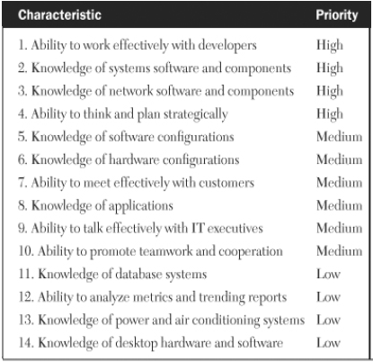
Capacity Planning
How to Develop an Effective Capacity Planning Process - 1
There are 9 major steps associated with implementing a sound capacity
planning process.
Selecting an Appropriate Capacity Planning Process Owner
The first step of capacity planning process is to select an appropriately qualified individual to serve as the process owner
He is responsible for designing, implementing and maintaining the process & is empowered to negotiate with developers and other support groups
The role needs to communicate effectively with developers and should be knowledgeable on systems and network Hardware and software components along with their configurations.

Slide 30
Capacity Planning
How to Develop an Effective Capacity Planning Process - 2
Identifying the Key Resources to be Measured
The next activity of the Process Owner would be to identify the infrastructure resources that must have their utilizations or performance measured based on current knowledge about which resources are most critical to meeting future capacity needs
These could be resources like
Network bandwidth
The number and speed of Centralized Server Processors
Memory in the Centralized servers
The number, size or density of Disk Volumes of the secondary storage
IO channels/Buses
Tape drives
Desktop processors
Desktop disk space
Desktop memory
Centralized printers

Slide 31
Capacity Planning
How to Develop an Effective Capacity Planning Process - 3
Measure the Utilizations and Performance of the Resources
Once the resources are identified, the next activity of the Process Owner would be to measure utilizations or performance
These measurements will help to understand the quantity of excess capacity available for each component and also helps to get an utilization baseline and enhances the ability to analyze and predict future trends
Compare Utilizations to Maximum Capacities
The utilization or performance of each component measured should be compared to the maximum usable capacity which is typically ~80% of the total capacity
By extrapolating the utilization trending reports and comparing them to the maximum usable capacity, the process owner will be able to estimate at what point a given resource is likely to exhaust its excess capacity.

Slide 32
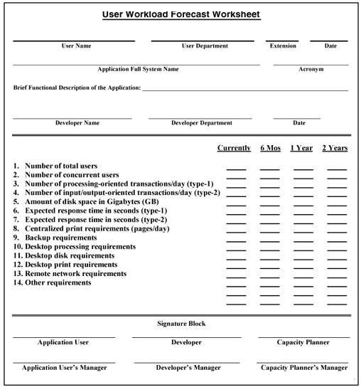
Capacity Planning
How to Develop an Effective Capacity Planning Process - 4
Collect Workload Forecasts from Developers and Users
Developers are usually asked to help users complete IT workload forecasts. This could be through a worksheet which is customized for the unique environment

Slide 33
Capacity Planning
How to Develop an Effective Capacity Planning Process - 5
Transform Workload Forecasts into IT Resources Requirements
Projected changes must be transformed into IT resource requirements which can be done by tools or an experienced analyst or performance centers/models offered by vendors.
These projections will be in terms of capacity needed and the timeframes when the workload is projected to increase
Map Requirements onto Existing Utilizations
The projected resource requirements derived from the workload projections of the users in Step 6 can be mapped to excess utilization seen in earlier steps and the delta capacity needed is estimated to meet the expected demand
Predict When the Shop Will Be Out of Capacity
This in conjunction with forecasts can also tell us when the additional capacity is needed.
Update Forecasts and Utilizations
Capacity Planning is a continuous periodic activity which can help keep an updated plan

Slide 34
Capacity Planning
Additional Benefits of Capacity Planning Process
A comprehensive capacity planning program offers other benefits over the projection of when, how much, and what type of additional hardware resources will be needed.
Strengthens the relationships with developers and end‐users
Since the process involves meeting with key users & discussing anticipated workloads, this usually strengthens relationships between IT infrastructure staff & its customers.
Communication, negotiation, and a sense of joint ownership can all combine to nurture a healthy, professional relationship between IT and its customers.
Improves communications with suppliers
Involving key suppliers and support staffs with capacity plans can promote effective communications among these groups.
This can also help in the groups meeting deadlines, reducing costs, and offering additional alternatives for capacity upgrades
Encourages collaboration with other infrastructure groups
Promotes a culture of strategic planning as opposed to tactical firefighting
Periodic ongoing capacity planning facilitates institutionalizing a strategic planning culture
Notes:
Helpful Hints for Effective Capacity Planning
1. Start small.
2. Speak the language of your customers.
3. Consider future platforms.
4. Share plans with your suppliers.
5. Anticipate nonlinear cost ratios.
6. Plan for occasional workload reductions.
7. Prepare for the turnover of personnel.
8. Strive to continually improve the process.
9. Evaluate the hidden costs of upgrades.

Slide 35
Capacity Planning
Hints for Effective Capacity Planning
Start Small
Speak the Language of Your Customers
Consider Future Platforms
Share Plans with Suppliers
Anticipate Nonlinear Cost Ratios
Plan for Occasional Workload Reductions
Prepare for the Turnover of Personnel
Strive to Continually Improve the Process
Evaluate the Hidden Costs of Upgrades

Slide 36
Capacity Planning
Uncovering the Hidden Costs of Upgrades
Some of the usually overlooked expenses associated with Capacity upgrade are
1. Hardware maintenance
2. Technical support
3. Software maintenance
4. Memory upgrades
5. Channel upgrades
6. Cache upgrades
7. Data backup time
8. Operations support
9. Offsite storage
10. Network hardware
11. Network support
12. Floor space
13. Power and air conditioning
Notes:
Discuss on the same

Slide 37
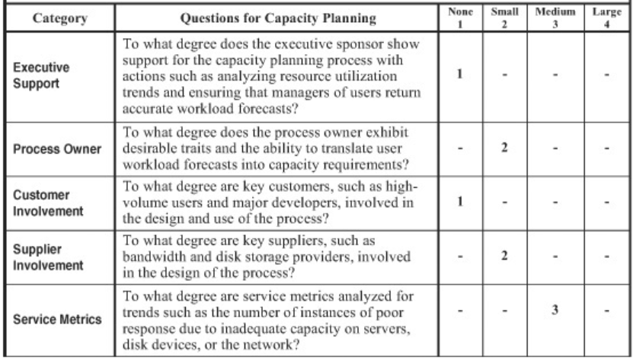
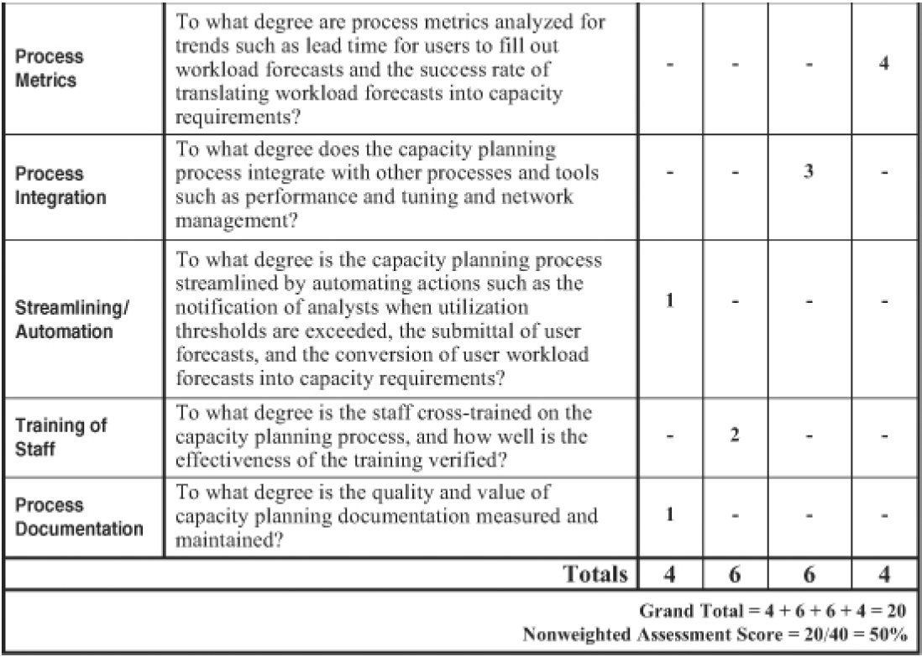
Capacity Planning
Assessing an Infrastructure’s Capacity Planning Process
Like with the other processes, the following worksheet quick-and-simple method for assessing the overall quality, efficiency, and effectiveness of a capacity planning process.

Slide 38
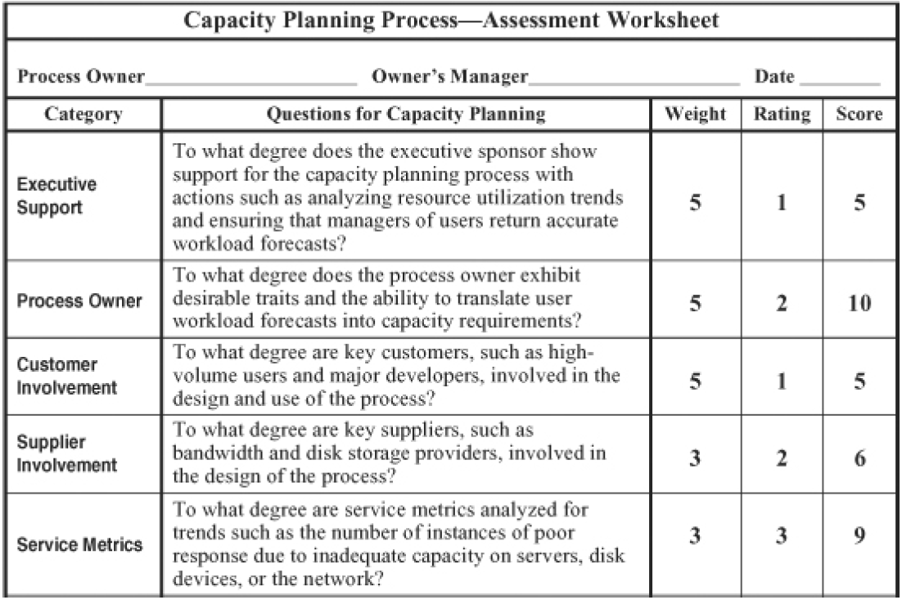
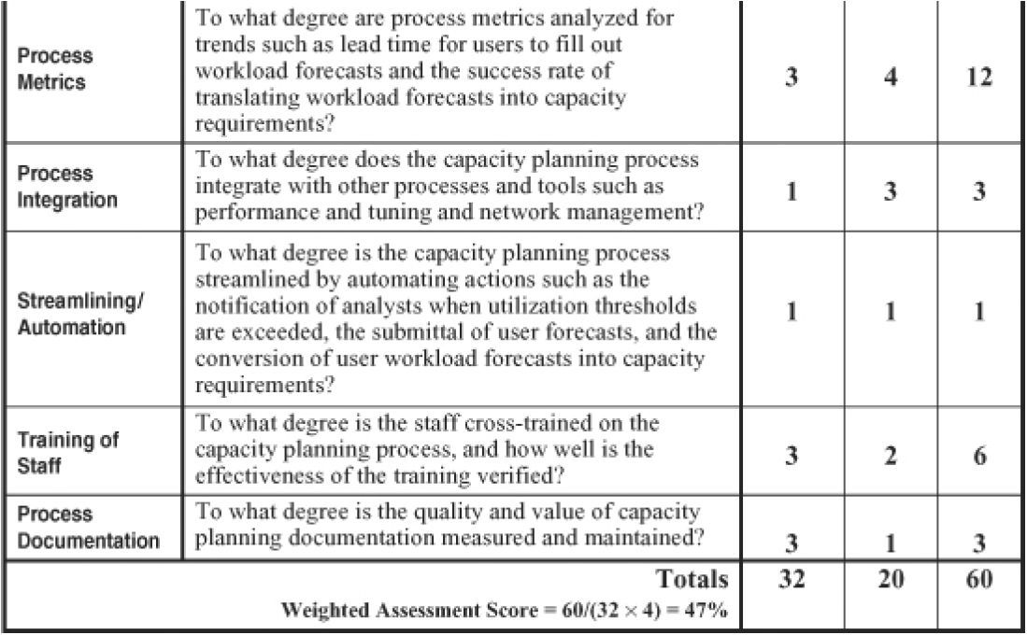
Capacity Planning
Assessing an Infrastructure’s Capacity Planning Process
If we need to tailor this for a specific organization, then with weightages

Slide 39
Capacity Planning
Measuring and Streamlining the Capacity Planning Process
We can measure and streamline the Capacity Planning process with the help of the assessment worksheet
We can measure the effectiveness of a capacity planning process with service metrics such as the number of instances of poor response due to inadequate capacity on servers, disk devices, or the network.
Process metrics such as lead time for users to fill out workload forecasts, success rates of converting forecasts into capacity requirements etc. help us gauge the efficiency of this process.
We can streamline the capacity planning process by automating certain actions for e.g. The notification to analysts when utilization thresholds are exceeded, the submittal of user forecasts, and the conversion of user-workload forecasts into capacity requirements

Slide 40
Discussions
Capacity Planning
Have you participated in any a capacity planning exercise till now?
On what basis was the capacity plans based on?
Have you been exposed to any tools or approaches which are used for modelling for capacity planning?
Notes:
Enterprise resource planning tool Saviom
Device42

